Slide 1


FRAUD DETECTION
- USING MACHINE LEARNING
Presented By :
Kedharish

Slide 2





AGENDA
MODEL DEVELOPMENT & METHODOLOGY
INTRODUCTION
CONCLUSION
Discuss reasons behind fraudulent transactions and the importance of early detection for minimizing financial losses.
EXPLORATORY DATA ANALYSIS
Apply various machine learning algorithms, compare their performance, and evaluate results.
Summarize key findings, highlight the importance of the chosen approach, and suggest improvements for future work.
Identify patterns and trends in the data to gain valuable insights for fraud detection.
DATA GATHERING AND PREPARATION
FEATURE ENGINEERING
MODEL EVALUATION AND RESULTS
Select and transform key features for model training using machine learning techniques.
Provide a comprehensive dataset overview, including data cleaning, refinement, and preparation steps.
Present model performance metrics, including accuracy and confusion matrix, along with visual comparisons.

Slide 3
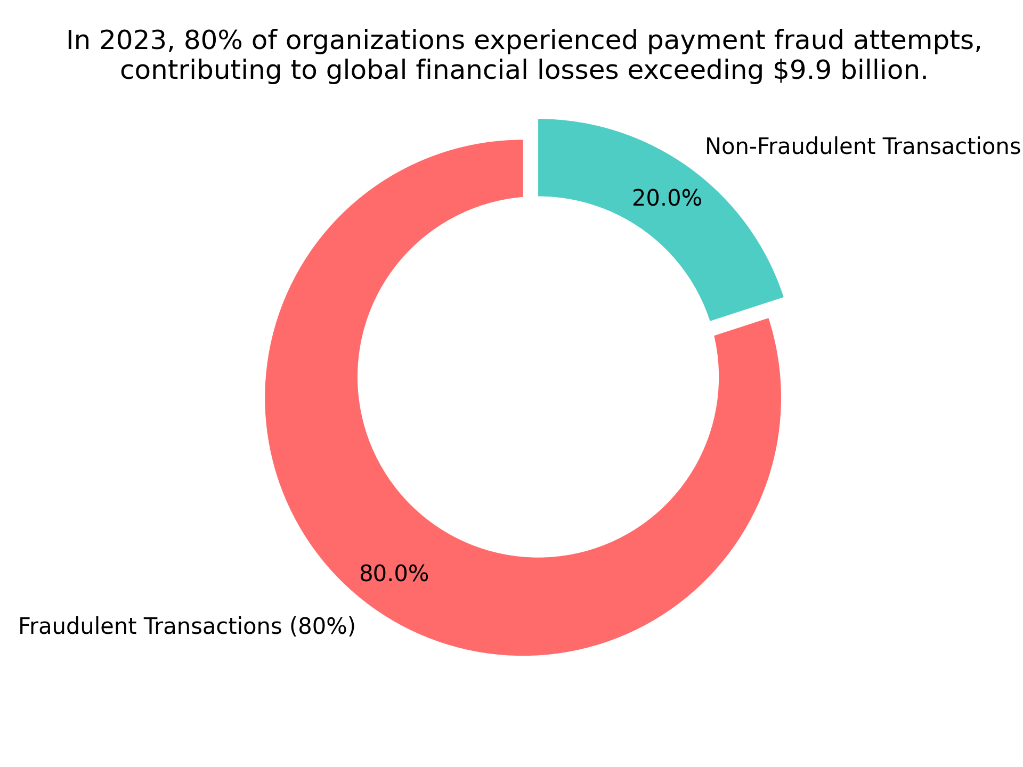
INTRODUCTION
This project focuses on developing a real-time machine learning model to detect fraudulent financial transactions. With the rise in digital payments, detecting suspicious activities is crucial to prevent financial losses and enhance security. Machine learning techniques enable accurate identification of fraud patterns, reducing manual intervention and streamlining operations. The project involves thorough data analysis, feature engineering, and model evaluation to ensure optimal performance. Ultimately, the goal is to create a reliable system that safeguards financial transactions efficiently.

Slide 4

OBJECTIVE OF THE STUDY
Objective:
Detecting fraudulent transactions in real-time is
vital for securing finances and building
customer trust.
Our goal is to create a machine learning
model that accurately identifies suspicious
activities, reducing financial losses and
strengthening operational safety.
Additional Objectives:
Understand Fraud Patterns: Conduct
in-depth data analysis to uncover trends and behaviors linked to fraudulent activities.
Deploy Scalable Solutions: Build a machine learning model that can adapt to growing data and evolving fraud techniques while maintaining high accuracy.
Why This Objective Matters:
Real-time detection minimizes financial
losses by stopping fraud before it escalates.
It enhances customer trust by providing
secure transaction experiences.
Early fraud detection helps avoid regulatory penalties and strengthens brand reputation.
Why Real Time Fraud Detection
Reduces operational risks associated with fraudulent activities.
Minimizes legal and regulatory penalties through proactive detection.
Improves customer retention by ensuring secure transaction

Slide 5

Monitor and Update
STEP
Continuously monitor the model's performance in the real-world scenario
07
Model Evaluation
STEP
06
Assessing the performance of a machine learning model using metrics
Model Selection and
Model Training
STEP
Choosing a suitable machine learning algorithm and optimizing its parameters
05
WORK FLOW
Split Train And Test Data
WORK FLOW
STEP
04
Dividing the dataset into training and testing sets to evaluate
PREPROCESSING
STEP
Preparing and cleaning data to enhance its quality and suitability
03
Exploratory Data Analysis
STEP
02
Analyzing and visualizing data patterns to understand its characteristics
Data Collection
STEP
Gathering and organizing data to train machine learning models.
01

Slide 6

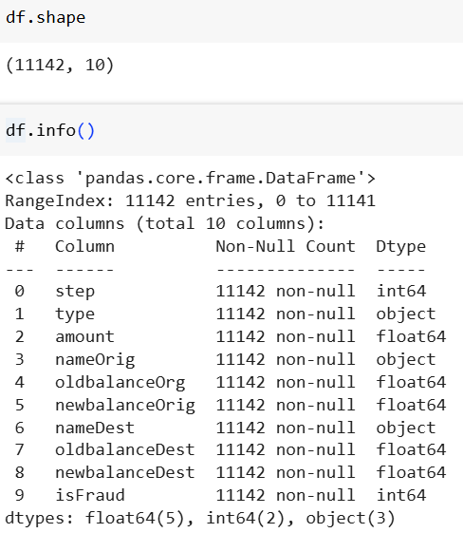
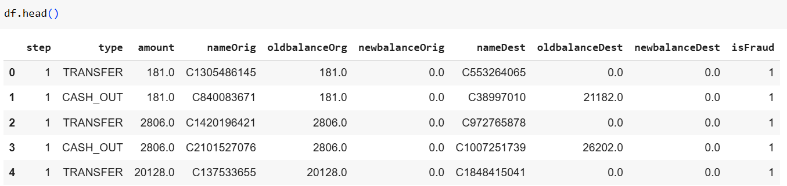
DATA OVERVIEW
Step: 1 step = 1 hour.
Type:
CASH-IN: Deposit funds.
CASH-OUT: Withdraw funds.
DEBIT: Reduces balance (withdrawals/expenses).
PAYMENT: Payment for goods/services.
TRANSFER: Move funds between accounts.
Transaction Details:
Amount: Transaction value.
nameOrig: Sender
oldbalanceOrg/newbalanceOrig: Sender’s balance before/after transaction.
nameDest: Recipient.
oldbalanceDest/newbalanceDest: Recipient’s balance before/after transaction (not for merchants).
Fraud Indicator::
isFraud: Marks fraudulent transactions where agents transfer and cash out funds illegally.

Slide 7
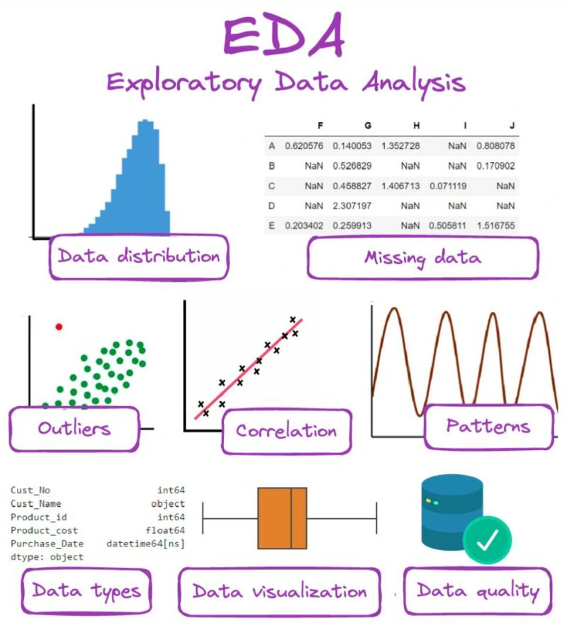
EXPLORATORY DATA ANALYSIS
What is EDA?
Exploratory Data Analysis (EDA) is the process of analyzing datasets to summarize their main characteristics, often using visual methods. It helps in understanding data patterns, spotting anomalies, checking assumptions, and determining relationships between variables before building predictive models. EDA is essential for ensuring data quality and making informed decisions during the modeling process.
EDA typically involves:
Summarizing main features of the dataset.
Identifying patterns, trends, and relationships.
Detecting outliers and missing data.
Formulating hypotheses and assumptions for further analysis.
Selecting appropriate variables for modeling.
Why EDA is Important
Data Cleaning: Detect and handle missing values, duplicate data, and incorrect data entries.
Insight Discovery: Reveal hidden patterns and relationships between variables.
Model Preparation: Ensure that the dataset is suitable for machine learning by encoding categorical variables and scaling features.
Risk Mitigation: Identify potential issues that may affect the accuracy of predictive models.

Slide 8
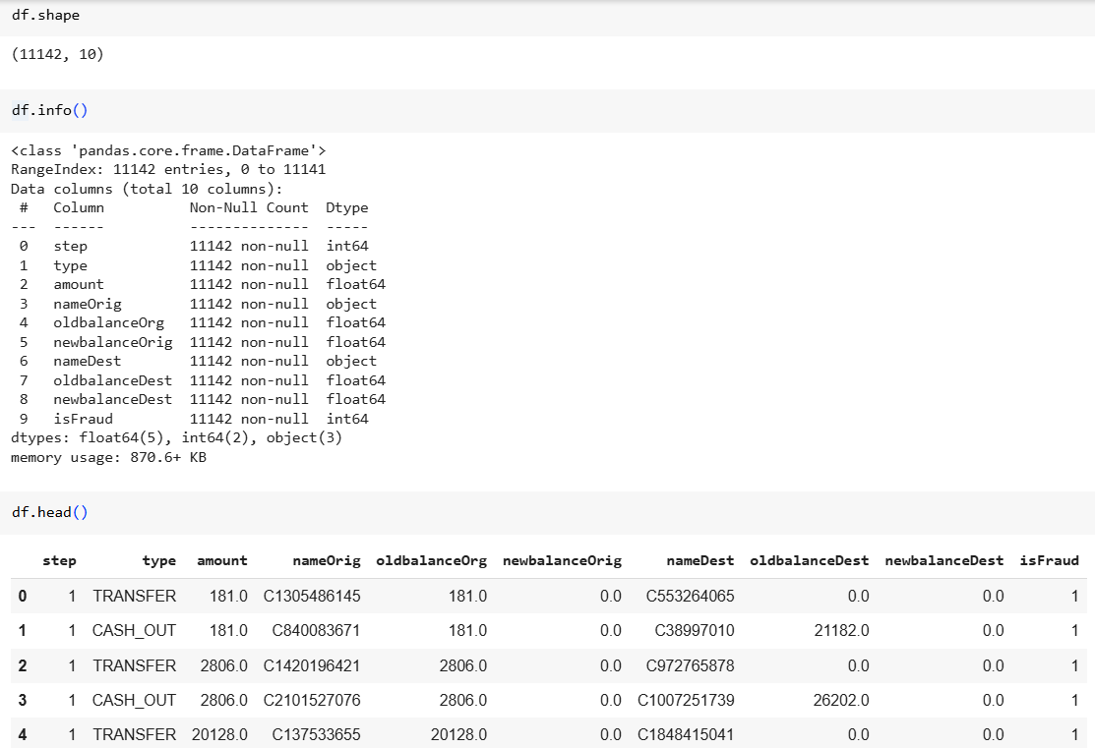
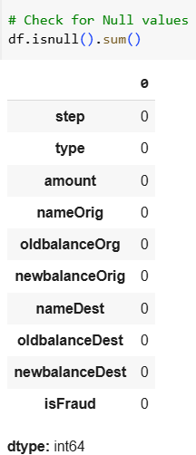
EDA STEPS & KEY FINDINGS
Techniques Used:
df.shape to check dataset dimensions.
df.info() for data types and non-null counts.
df.head() to preview the first few rows.
df.describe() for statistical summary.
Df.isnull().sum() to detect missing values.
Findings:
The dataset contains a sufficient number of rows and columns for analysis.
All columns have appropriate data types, with no major data loading issues.
The statistical summary provides an understanding of mean, standard deviation, and distribution of numeric columns.

Slide 9
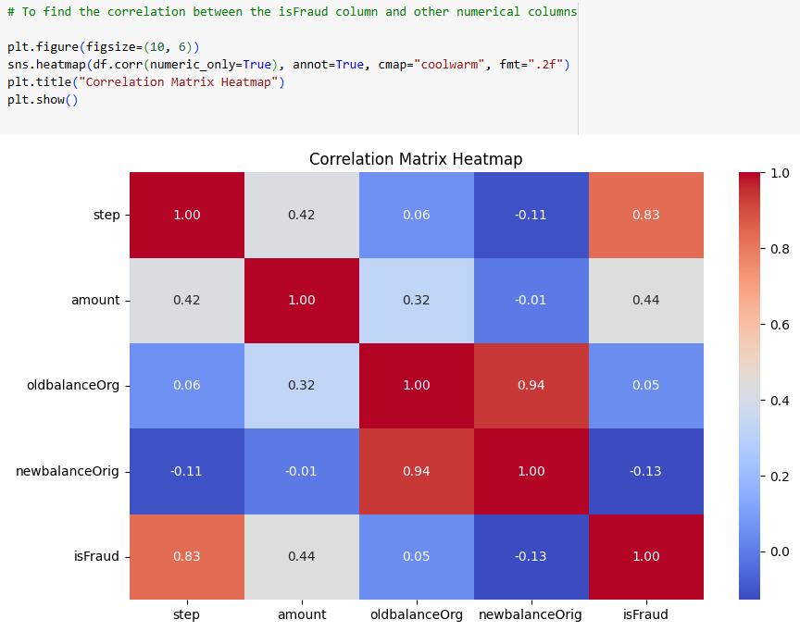
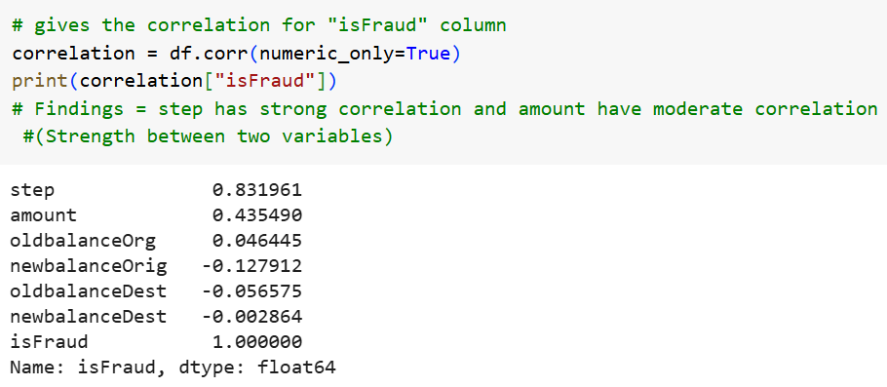
CORRELATION ANALYSIS
Techniques Used:
df.corr(numeric_only=True) to calculate correlations.
Heatmap visualization (sns.heatmap) for correlation insights.
Findings:
The step feature shows a strong correlation with isFraud.
The amount feature has a moderate correlation with isFraud.
Certain transaction types also show patterns related to fraudulent activities.

Slide 10
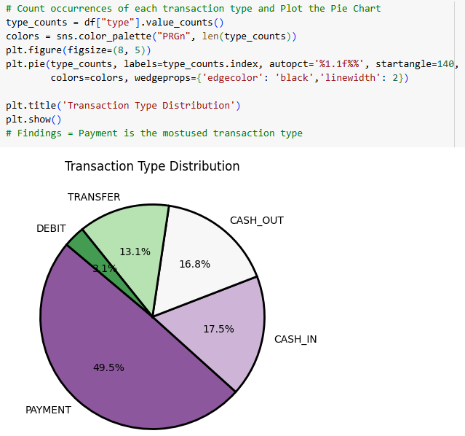
TRANSACTION TYPE ANALYSIS
Techniques Used:
df.type.value_counts() to count transaction types.
Pie chart visualization (plt.pie) for distribution insights.
Findings:
"Payment" is the most frequent transaction type.
The distribution of transaction types suggests focusing on patterns in common transactions for fraud detection.

Slide 11
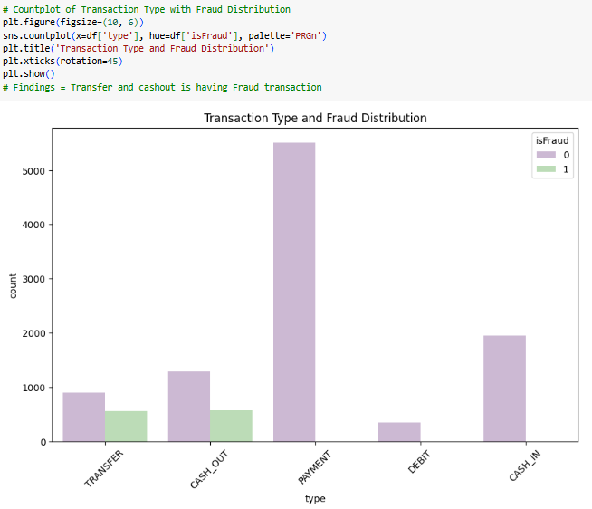
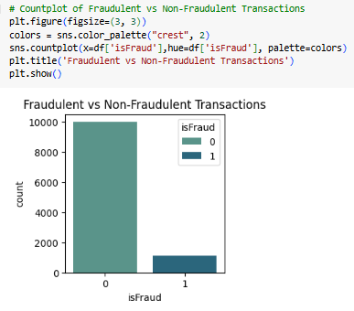
ADITIONAL ANALYSIS
This chart shows the transaction type and distribution
Findings:
TRANSFER AND CASH_OUT has more fraudulent activity
This chart shows the count of Fraudulent vs Non-Fraudulent Transaction using Countplot

Slide 12
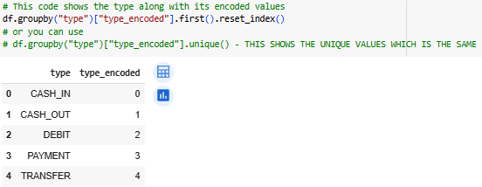
FEATURE ENGINEERING
Objective of Feature Engineering:
Enhance the model's ability to detect fraudulent transactions by creating features that highlight suspicious patterns.
Improve model accuracy by transforming raw data into meaningful inputs.
Type encoded
Description: A numerical representation of transaction types (e.g., PAYMENT, CASH_OUT, TRANSFER)
Purpose: Machine learning models work best with numerical data. Encoding categorical variables allows the model to interpret different transaction types.
Impact: Highlights patterns in transaction behavior associated with fraud.

Slide 13
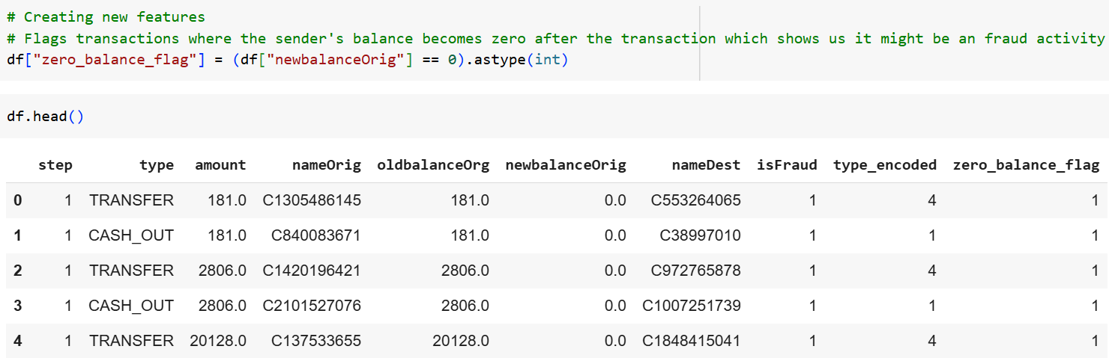
Zero_balance_flag
Formula :
If New Balance Original equals 0, then flag = 1; otherwise, flag = 0.
Explanation:
This creates a binary flag to indicate if the sender’s balance became zero after the transaction.
A value of 1 means the balance is zero (potential fraud), and 0 means otherwise.

Slide 14
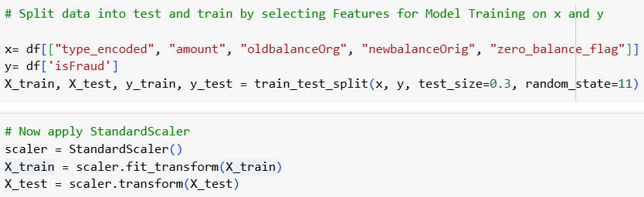
SPLITTING DATASET INTO TRAINING AND TESTING SET
Splitting Data: Dividing data into training and testing sets ensures the model learns from one portion and is evaluated on unseen data, helping to check its real-world performance and avoid overfitting.
Scaling Data: Scaling standardizes features, ensuring all variables contribute equally to the model and improving the performance of algorithms sensitive to feature magnitude, like Logistic Regression.
Train-Test Split (80/20): Divides data for model training (80%) and evaluation (20%).
stratify=y: Keeps the same fraud distribution in both sets.
StandardScaler(): Scales features for better model accuracy.

Slide 15
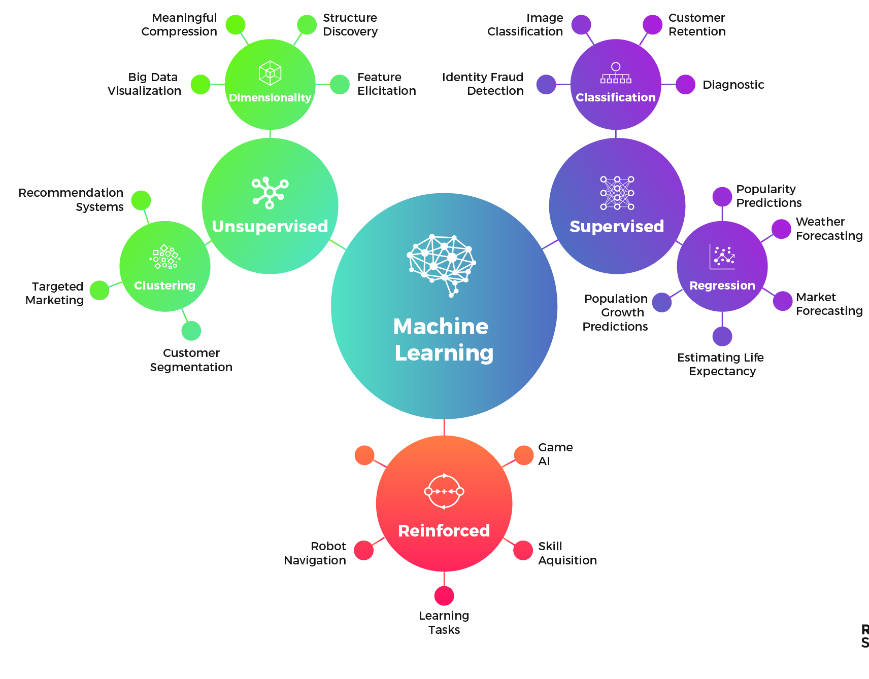
TRAINING MACHINE LEARNING MODEL
Logistic Regression: A simple, fast model used for binary classification (e.g., fraud detection). It predicts the probability of a class and works well when data is linearly separable.
Decision Tree: A tree-like model that splits data based on feature values. It’s easy to interpret and handles non-linear relationships but can over fit on complex datasets.
Random Forest: An ensemble of decision trees that improves accuracy and reduces overfitting by averaging multiple trees' predictions. Ideal for handling complex data with high variance.

Slide 16
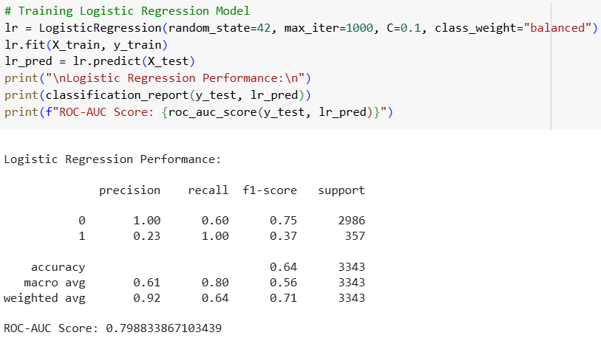
LOGISTIC REGRESSION
Model Details:
Regularization (C=0.1): Prevents overfitting by penalizing large coefficients.
Balanced Class Weights: Addresses class imbalance by assigning higher weight to the minority class (fraud cases).
max_iter=1000: Ensures the model converges during training.
Performance Metrics:
Precision (Fraud = 1): 23% — Of all transactions predicted as fraud, only 23% were correct.
Recall (Fraud = 1): 100% — The model identified all actual fraud cases (no false negatives).
F1-Score (Fraud = 1): 0.37 — Harmonic mean of precision and recall, indicating moderate performance.
Accuracy: 64% — Overall correctness of the model's predictions.
ROC-AUC Score: 0.80 — Good discrimination ability between fraud and non-fraud cases.
Insights:
The model detects all fraud cases (high recall) but misclassifies many non-fraud transactions as fraud (low precision).
Suitable when catching all fraud is more important than reducing false alarms.

Slide 17
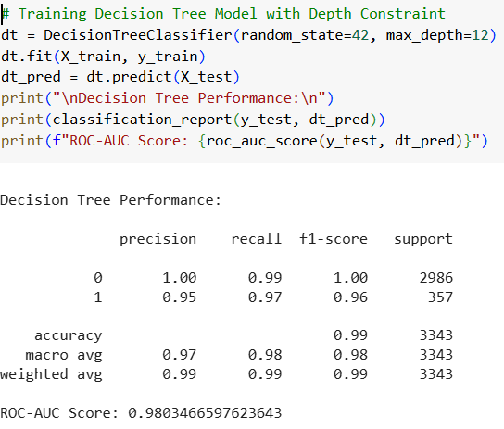
DECISION TREE MODEL
Model Details:
max_depth=12: Limits the depth of the tree to prevent over fitting while capturing essential patterns.
random_state=42: Ensures reproducibility of results.
Performance Metrics:
Precision (Fraud = 1): 95% — The model correctly identifies 95% of fraud predictions.
Recall (Fraud = 1): 97% — It detects 97% of actual fraud cases, with minimal missed fraud.
F1-Score (Fraud = 1): 0.96 — Strong balance between precision and recall.
Accuracy: 99% — High overall accuracy, showing excellent classification.
ROC-AUC Score: 0.98 — Outstanding ability to differentiate between fraud and non-fraud transactions.
Insights:
The model performs exceptionally well, identifying most fraud cases with minimal false positives.
Highly reliable for fraud detection but still interpretable due to the controlled tree depth.

Slide 18
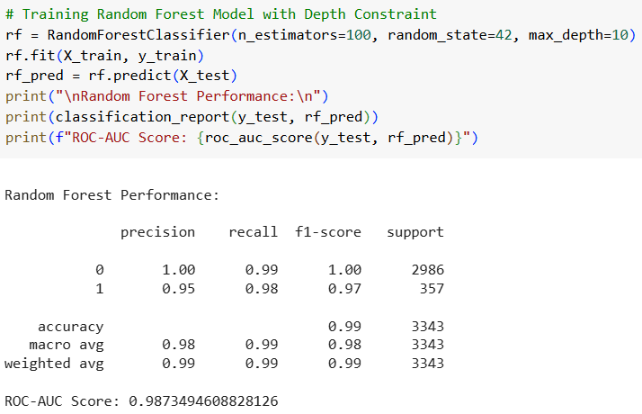
RANDOM FOREST MODEL
Model Details:
n_estimators=100: Combines 100 decision trees for robust predictions.
max_depth=10: Restricts tree depth to avoid overfitting while maintaining performance.
random_state=42: Ensures consistent and reproducible results.
Performance Metrics:
Precision (Fraud = 1): 95% — Accurately identifies 95% of predicted fraud cases.
Recall (Fraud = 1): 98% — Detects 98% of actual fraud cases, with very few missed frauds.
F1-Score (Fraud = 1): 0.97 — Excellent balance between precision and recall.
Accuracy: 99% — High overall accuracy with minimal misclassifications.
ROC-AUC Score: 0.987 — Exceptional performance in distinguishing fraud from non-fraud transactions.
Insights:
The Random Forest model outperforms other models with the highest ROC-AUC score.
Highly accurate and robust, making it ideal for fraud detection with low risk of overfitting.

Slide 19
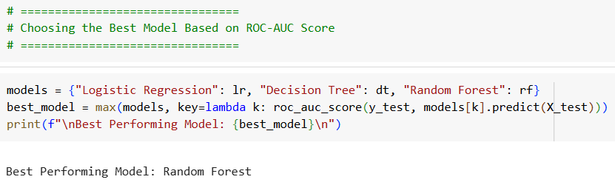
MODEL PERFORMANCE
Key Findings:
Top Performing Model: The Random Forest model achieved the highest accuracy (99.28%) and recall (98.03%), making it the most effective in detecting fraudulent transactions while minimizing missed fraud cases.
Financial Impact: Random Forest saved the most amount financially by accurately identifying fraud cases, reducing potential losses compared to other models.
Limitations:
Low Precision in Logistic Regression: The Logistic Regression model had a low precision (22.98%), leading to many false positives, which could cause customer dissatisfaction due to legitimate transactions being flagged as fraudulent.
Scalability Issue: The Random Forest model, despite its performance, may face scalability challenges when deployed for real-time fraud detection due to its computational complexity.

Slide 20
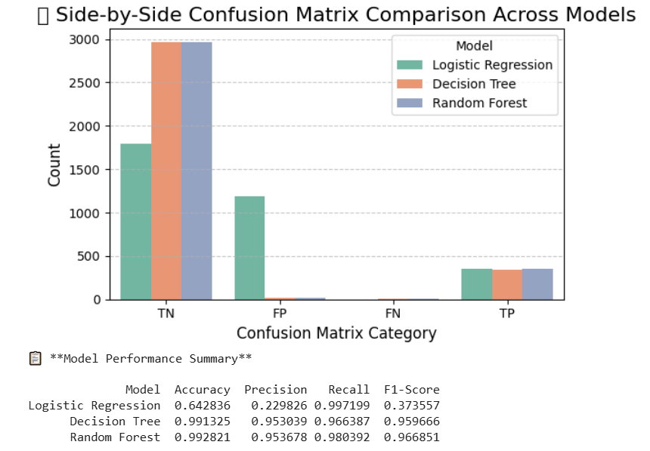

Slide 21
MOST ASKED QUESTIONS
How can the model be improved further?
By applying cost-sensitive learning, enhancing feature engineering, and using real-time data pipelines.
Is the model suitable for real-time deployment?
Random Forest may require optimization for real-time deployment due to high computational complexity.
Why did the Random Forest model perform better than the others?
Random Forest handles non-linear data well and reduces overfitting by combining multiple decision trees.
How much financial loss was prevented by the model?
The Random Forest model saved the most financial amount by accurately detecting fraudulent transactions.
Why not choose Logistic Regression despite its high recall?
Logistic Regression had low precision (22.98%), causing too many false positives and potentially inconveniencing customers.

Slide 22
THANK YOU

